Slide 1
UNIT -II

Slide 2
API Design:
Define APIs with Restful API Modeling Language (RAML),
Test Designs with Mock APIs,
Make APIs Discoverable,
Create Public API Portals for External Developers,
API Builds:
Configure Mule Applications,
Access Databases Using Connectors,
API Deployment and Management:
Define Mule Application Deployment Options,
Create and Deploy API Proxies Using API Manager Restrict Access to API proxies with API Manager .
Mule Events:
Log Mule Event Data,
Debug Mule Applications,
Compose Event Properties, Create Variables.

Slide 3
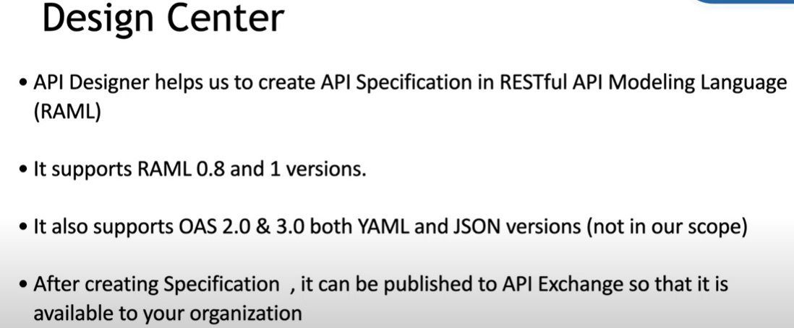

Slide 4
An API specification provides an understanding of how an API behaves.
What kind of Request it accepts?
What kind of Response it returns?
What are the mandatory fields/Data Types/ Security etc..
So before developing an API we need to Design an API ( API Specification)
Designing APIs ( API Specification) using Anypoint Platform Design Center

Slide 5
Restful API Modelling Language (RAML)
The RESTful API Modeling Language, or RAML, is an open source development language for describing RESTful APIs.

Slide 6
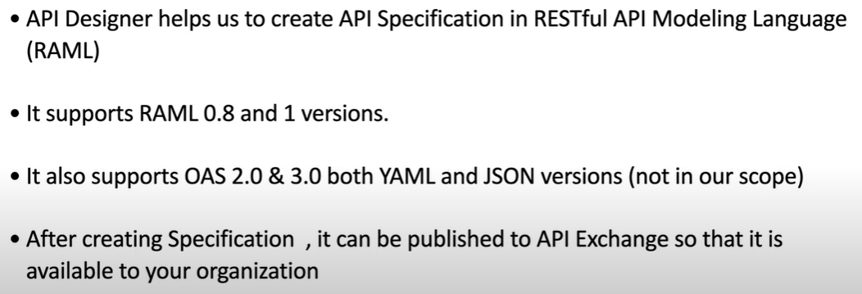
Design Center

Slide 7

Resources/EndPoints: It is the unique name we give to identify a resource
Method: GET, POST, PUT, DELETE, PUT, PATCH etc.
Request: Body, queryparams, uriparams, headers.
Response: response Body and response type
Http Status: 200,201,400,404,500 etc…
http://<domain>/<endpoint>?<qyery parameter>
No Two resources can have same name & method!

Slide 8
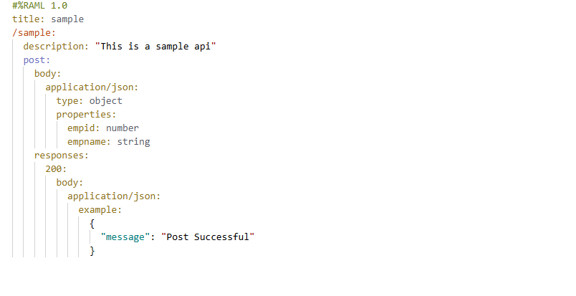

Slide 9
#%RAML 1.0
title: S6Demo
/Mule:
description: "S6 Demo"
post:
body:
application/json:
type: object
properties:
empid: number
empname: string
responses:
200:
body:
application/json:
example:
{
"Sucess"
}
/S6get:
description: "S6 get demo"
get:
responses:
200:
body:
application/json:
example:
{
"empid": 3,
"empname": "aaaa"
}

Slide 10
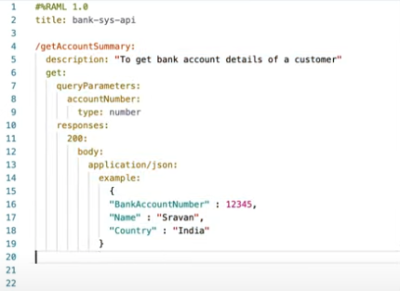

Slide 11
Steps to import RAML file to studio
How to Import RAML from the Design Center to Anypoint Studio?
The first step is to configure the Anypoint Platform with Anypoint Studio by the below
steps:
Windows Preferences--> AnypointStudio-->Authentication
Add (Provide credentials to connect with the Anypoint Platform)

Slide 12
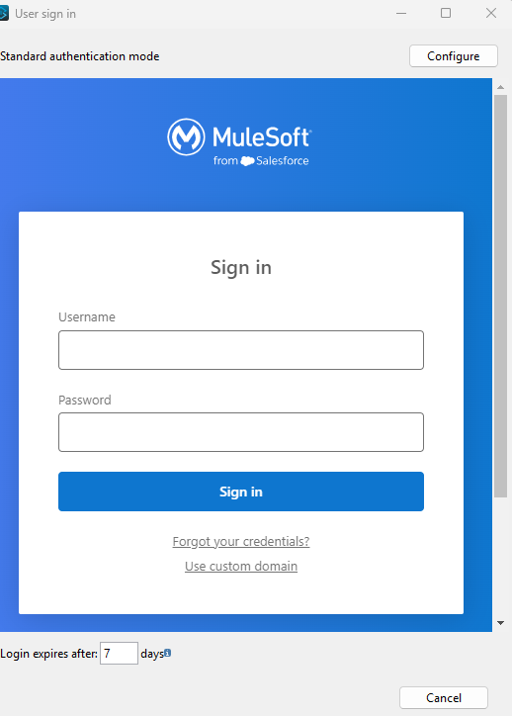
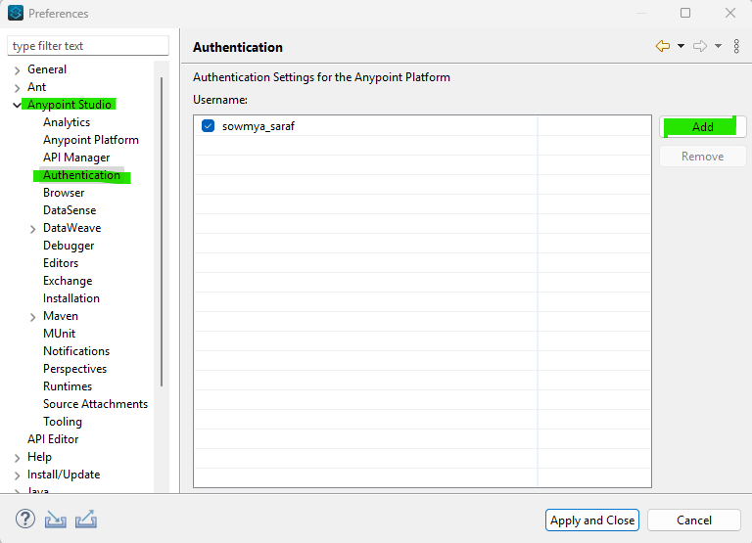
Steps to import RAML file to studio

Slide 13
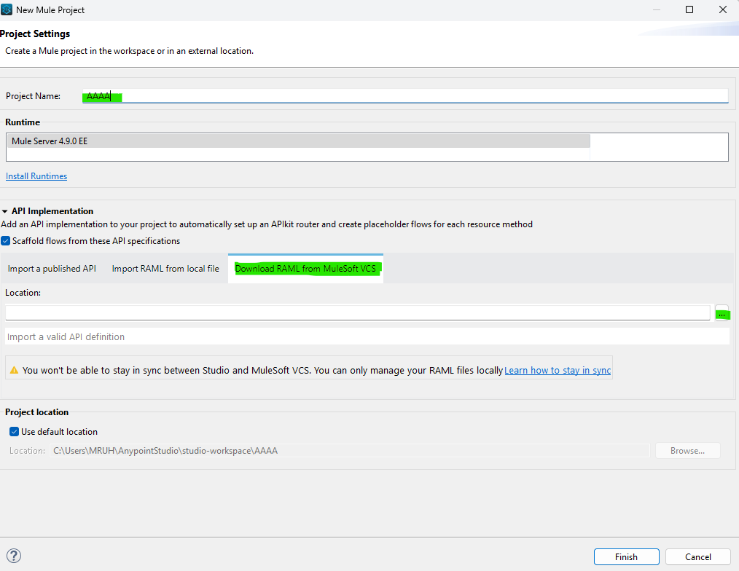
Steps to import RAML file to studio

Slide 14
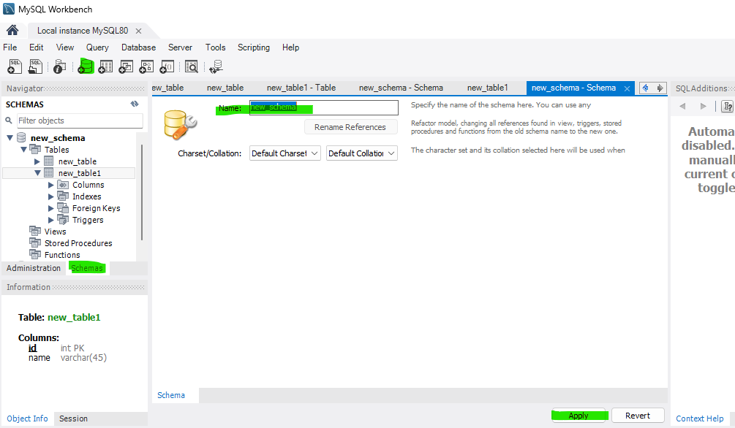
Steps to create database thru workbench

Slide 15
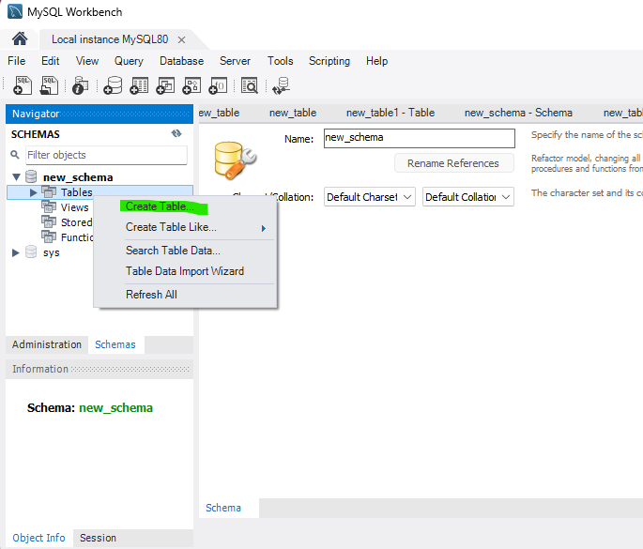
Steps to create database thru workbench

Slide 16
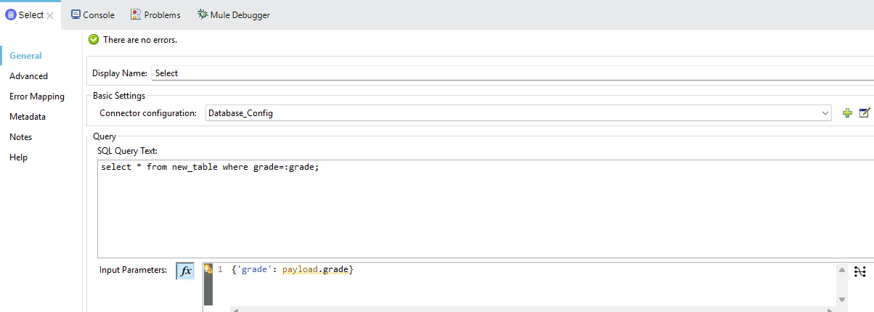
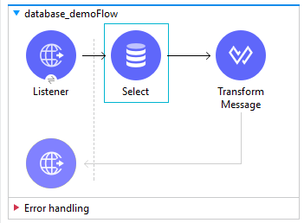
Steps to import database

Slide 17
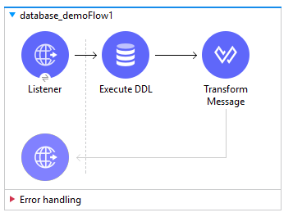
Create table from studio

Slide 18
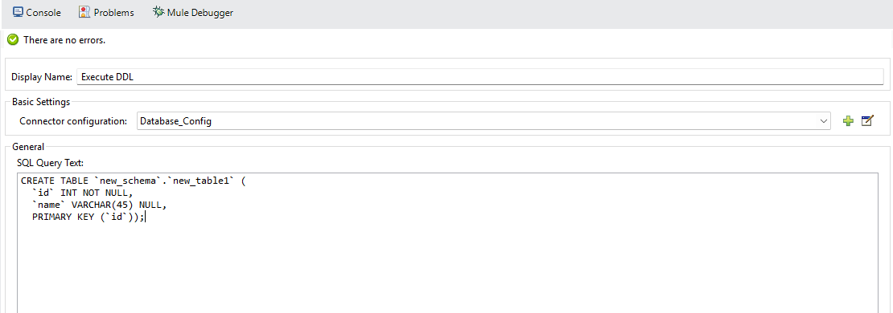
Create table from studio
CREATE TABLE `new_schema`.`new_table1` (
`id` INT NOT NULL,
`name` VARCHAR(45) NULL,
PRIMARY KEY (`id`));

Slide 19
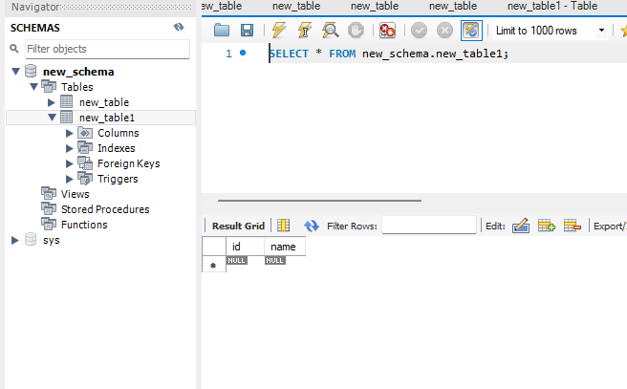
Create table from studio

Slide 20
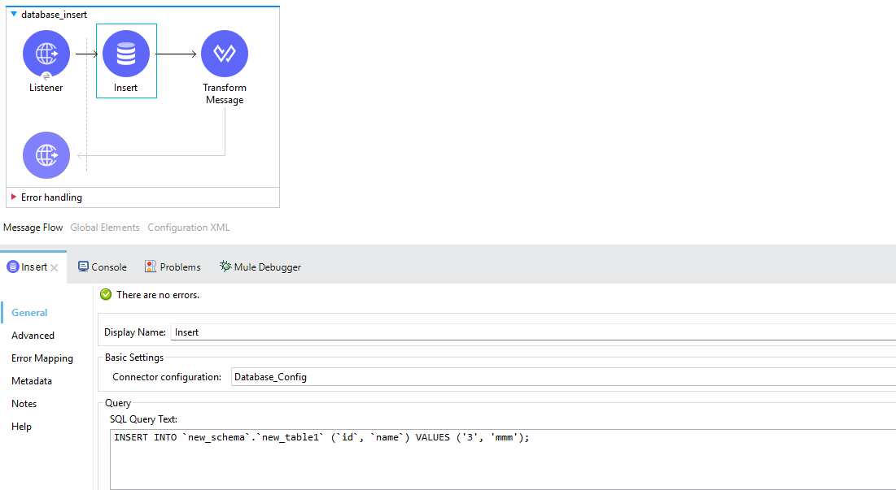
Insert into table from studio
INSERT INTO `new_schema`.`new_table1` (`id`, `name`) VALUES ('2', 'ddd');

Slide 21
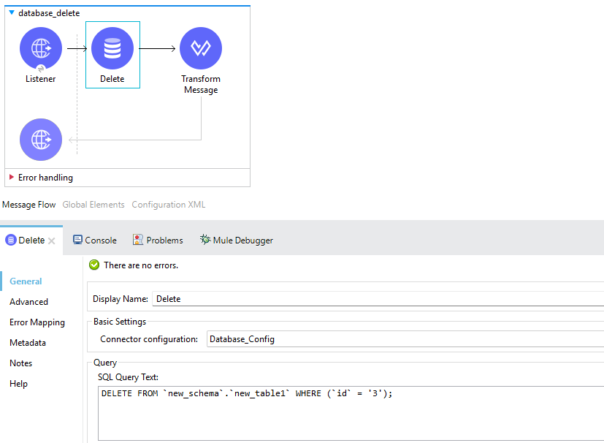
Delete from table from studio
DELETE FROM `new_schema`.`new_table1` WHERE (`id` = '3');

Slide 22
Define Mule Application Deployment Options
MuleSoft offers several deployment options for Mule applications, broadly categorized as CloudHub, hybrid, and on-premises. These options differ in how the Mule runtime environment is hosted and managed, offering varying degrees of control, scalability, and security.
CloudHub 2.0
CloudHub
Hybrid Deployments
Anypoint Platform Private Cloud Edition
Anypoint Runtime Fabric Deployments
https://docs.mulesoft.com/runtime-manager/deployment-strategies

Slide 23
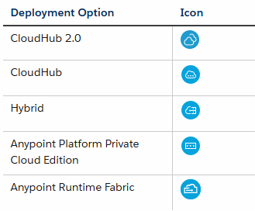
Define Mule Application Deployment Options

Slide 24
CloudHub 2.0:
CloudHub 2.0 is a fully managed, containerized integration platform as a service (iPaaS) where you can deploy APIs and integrations as lightweight containers in the cloud.
You can deploy your applications from the Anypoint Platform Runtime Manager cloud console and host them in CloudHub 2.0.

Slide 25
CloudHub
CloudHub is a complete integration platform as a service (iPaaS) that provides server functionality for you to deploy your applications without having to configure a hosting environment.
Based on your contract, you control how many resources to assign to your application.

Slide 26
Hybrid:
With the hybrid deployment option, you deploy your applications from the Runtime Manager cloud console to your Mule servers and use Runtime Manager to manage them.
This option provides you with flexibility and control over your on-premises security but requires you to provide the hosting infrastructure.
To use the hybrid option, you
first register your Mule servers with the Runtime Manager agent.
Then, from Runtime Manager, you can optionally add those servers to server groups or clusters to provide high availability.
Finally, you deploy your applications from Runtime Manager to either a server, server group, or cluster.

Slide 27
Anypoint Platform Private Cloud Edition
Anypoint Platform Private Cloud Edition is a containerized distribution of the management and engagement capabilities of Anypoint Platform that you host on-premises or in your organization’s private cloud environment.
If your organization has strict regulatory or compliance requirements that limit the use of cloud solutions, you can use Anypoint Platform PCE to deploy and host your applications on-premises.

Slide 28
Anypoint Runtime Fabric Deployments
Anypoint Runtime Fabric is a container service that automates the deployment of Mule applications and API gateways.
Runtime Fabric runs within a customer-managed infrastructure on AWS, Azure, virtual machines (VMs), and bare-metal servers.
To use the Runtime Fabric option, you first create a Runtime Fabric using Runtime Manager. Then, you install Runtime Fabric on your infrastructure.
Finally, you deploy your applications from the Runtime Manager cloud console to the Runtime Fabric you created

Slide 29
Mule Events
In MuleSoft integration, events play a crucial role in ensuring communication between two or more flows.
Within MuleSoft's Anypoint Studio, each flow that is triggered operates with its event and can make it possible to transfer data and control from one flow to another
A Mule event contains the core information processed by the runtime. It travels through components inside your Mule app following the configured application logic.
Mule event is immutable, so every change to an instance of a Mule event results in the creation of a new instance.

Slide 30
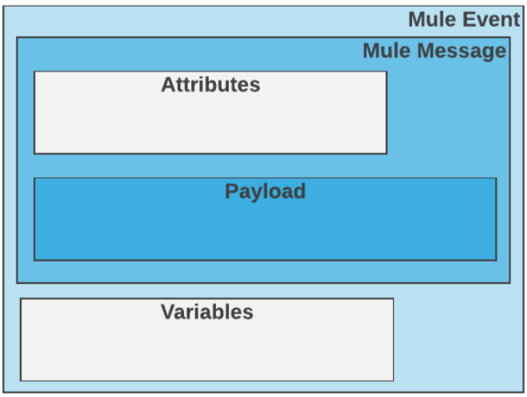
A Mule event is composed of these objects:
A Mule Message contains a message payload and its associated attributes.
Variables are Mule event metadata that you use in your flow.

Slide 31
A Mule event source (message source) triggers the generation of a Mule event and dispatches that event to the flow.
Examples of event sources include triggers, such as the Scheduler, and listeners, such as the HTTP Listener.

Slide 32
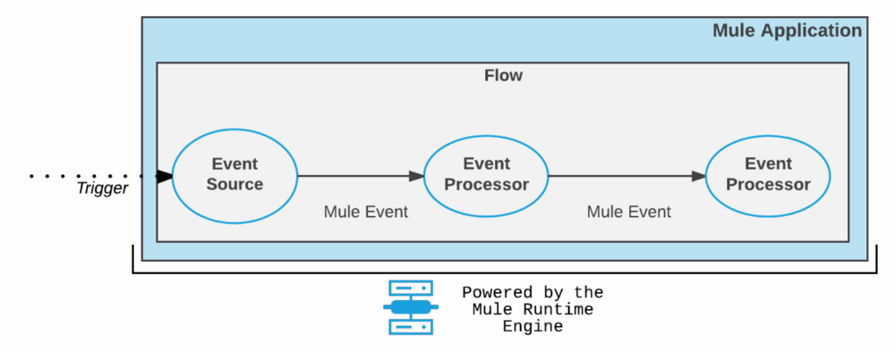
A trigger reaches the event source.
The event source produces a Mule event.
The Mule event travels sequentially through the components of a flow.
Each component interacts in a pre-defined manner with the Mule event.

Slide 33
notes
A Mule Event contains all the core information processed by the Mule runtime. A Mule event is triggered by a message source, such as a Listener or an HTTP request. These Mule Events are critical for the smooth execution of flows in an API creation. As we discussed earlier, each flow has its event, and thus events are immutable, which means a small change to an instance of a Mule event will create a whole new instance. When an event is triggered, all the core information like attributes, payload, and variables are passed to the next processor.

Slide 34
references
Mule events
https://dzone.com/articles/understanding-mule-events-in-mule-4
https://docs.mulesoft.com/runtime-manager/deployment-strategies

